Slide 1
LAB : 03 PRESENTATION
TOPIC : Designing Of Form, Reports
Creation Of Relationship
Group Member : Waleed Alam
Ali Ahmad

Slide 2
OBJECTIVE :
The objective of this lab is to learn how to design a forms and reports, how to create relationships between tables and how to design a query.
Forms :
Forms provide a nice interface for entering data into tables and for viewing existing data. To create a form for the Employees table, first make sure that the table is open. Navigate to the Create tab, then in the Forms group, click on the Form button.

Slide 3
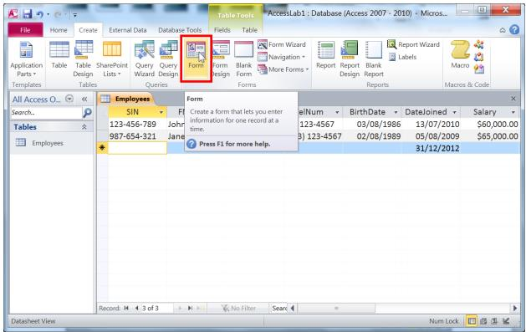
Example :

Slide 4
REPORTS:
Reports provide you with a read-only, printable view of tables, queries or a combination of them.You can make a report in the same way a form is created but let us try the Report Wizard. Go to the Create tab and click on Report Wizard in the Reports Group.

Slide 5
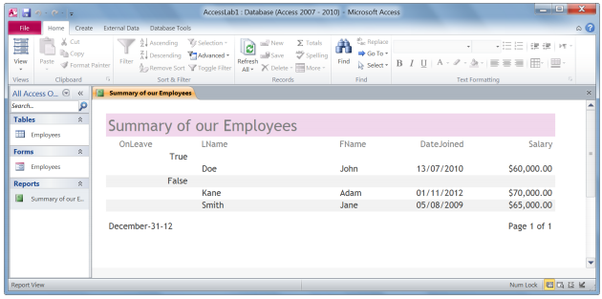
Example :

Slide 7
Relationships :
Tables are related by relationships in order to minimize data redundancy
TYPES :
1) A one-to-one relationship
2) A one-to-many relationship
3) A many-to-many relationship

Slide 8
1) A one-to-one relationship :
A one-to-one relationship is a link between the information in two tables, where each record in each table only appears once.

Slide 9
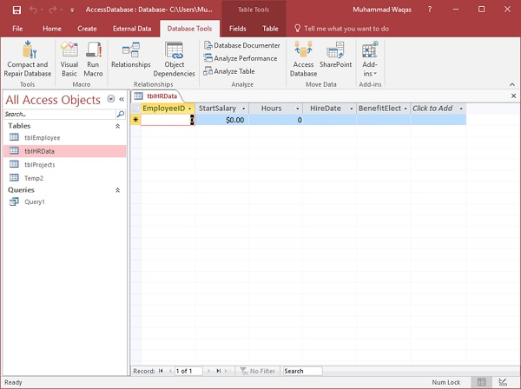
EXAMPLE :

Slide 10
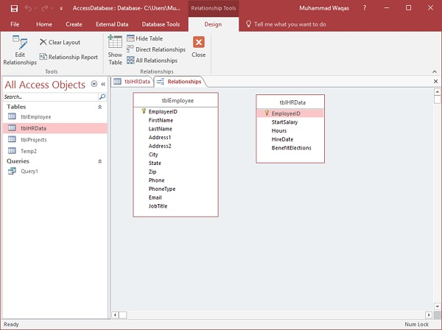

Slide 11
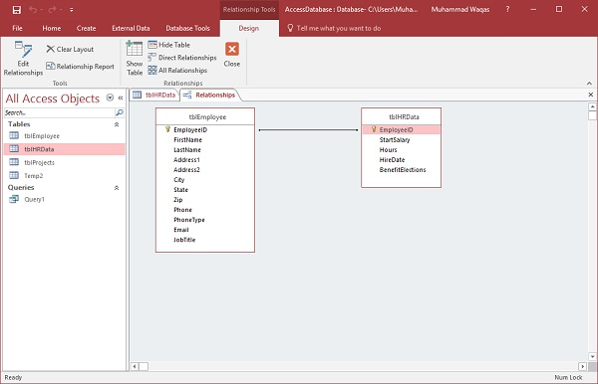

Slide 12
2)A one-to-many relationship:
A one-to-many relationship is the most common kind of relationship. In this kind of relationship, a row in table A can have many matching rows in table B. But a row in table B can have only one matching row in table A.

Slide 13
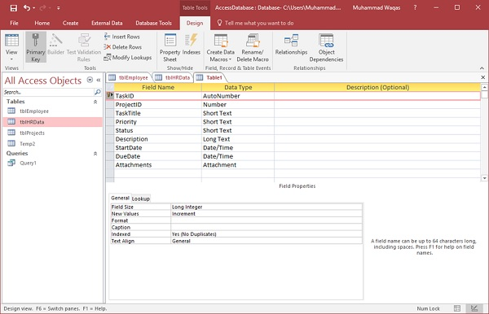
Example :

Slide 14
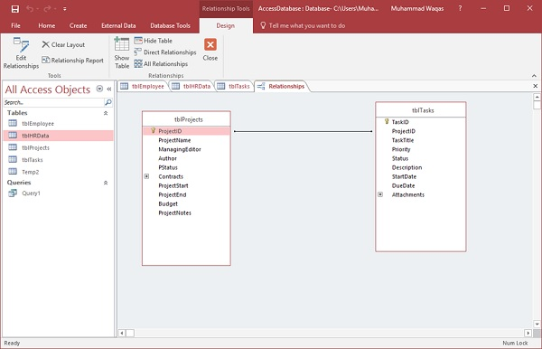

Slide 15
3)Many to Many Relationship :
A many-to-many relationship exists when one or more items in one table can have a relationship to one or more items in another table

Slide 16
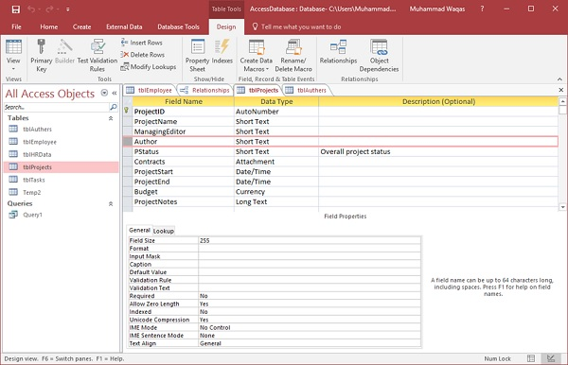
Example :

Slide 17
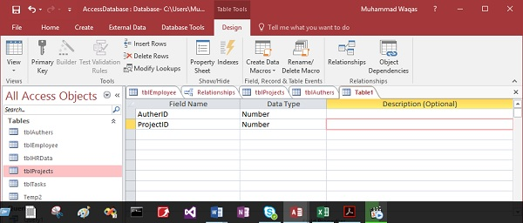

Slide 18
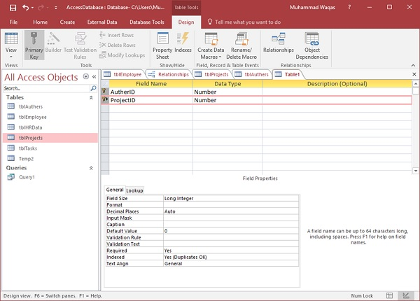

Slide 19
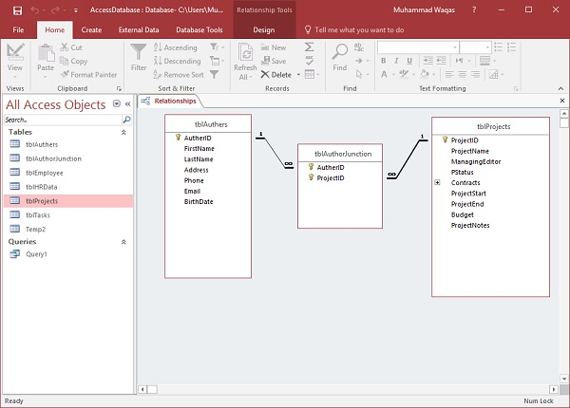

Slide 20
THANK YOU

